Slide 1


Artificial Intelligence
BEHAVIOR OF HEURISTICS EVALUATIONS
(USING HEURISTICS IN GAMES)
Faculty of Computing
Universiti Teknologi Malaysia

Slide 2
Course Contents
Again..Selected topics for our course. Covering all of AI is impossible!
Key topics include:
Introduction to Artificial Intelligence (AI)
Knowledge Representation and Search
Introduction to AI Programming
Problem Solving Using Search
Exhaustive Search Algorithm
Heuristic Search
Techniques and Mechanisms of Search Algorithm
Knowledge Representation Issues and Concepts
Strong Method Problem Solving
Reasoning in Uncertain Situations
Soft Computing and Machine Learning

Slide 3
HEURISTICS EVALUATIONS:
(Admissibility,Monotonicity and Informedness)
Admissibility Measures
  A search is admissible if it is guaranteed to find a minimal path to a solution whenever such a path exists
  Recall…
  f(n) = g(n) + h(n) estimates the total cost of path from start state through n to the goal state
start
g(n)
h(n)
n
goal
f(n)=total cost

Slide 4
Admissibility
A heuristic h(n) is admissible if for every node n,
h(n) ≤ h*(n), where h*(n) is the true cost to reach the goal state from n.
An admissible heuristic never overestimates the cost to reach the goal, i.e., it is optimistic.
eg. In 8-puzzle, heuristic of counting # of tiles out of place certainly ≤ # of moves required to move to the goal, hence this heuristic is admissible.
Best_First_Search + evaluation function Algorithm A
If h(n) <= h(n)*(cost of minimal path) Algorithm A*
Therefore, All A* algorithms are ADMISSIBLE.

Slide 5
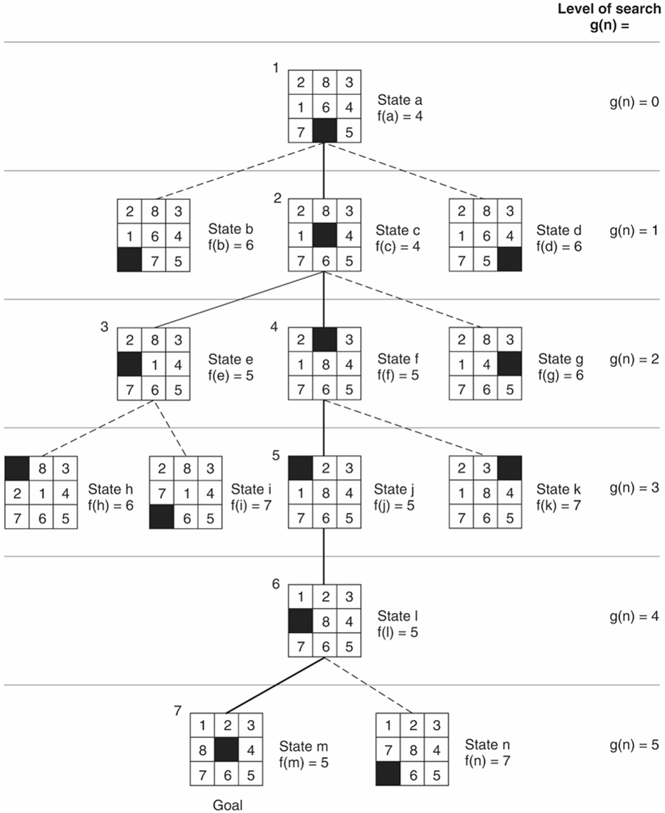
f(n)=g(n)+h(n)
g(n)=actual dist. From n to start
h(n)=no. of tiles in wrong position
State space generated in heuristic search of the 8-puzzle graph.
Full best-first-search of 8 puzzle

Slide 6
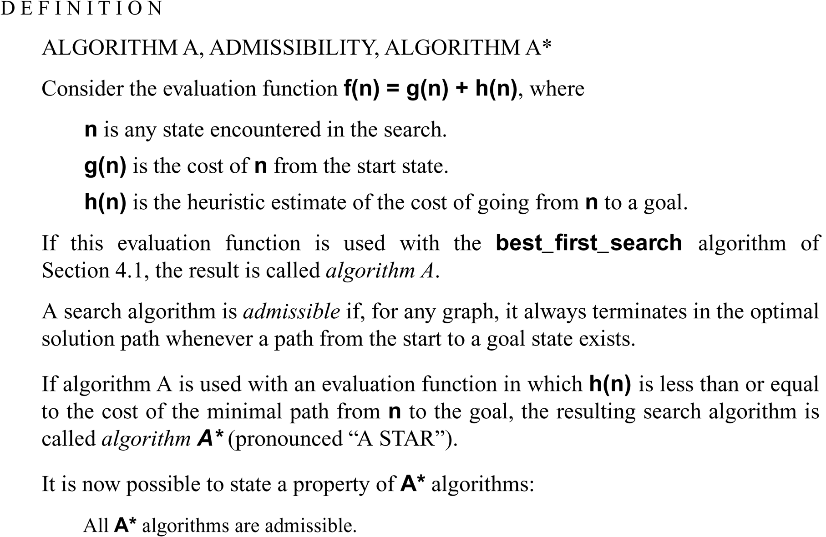

Slide 7
Monotonicity
Consistently find the minimal path to each state encountered in the search.
For best-first-search with monotonic heuristic, allows any state rediscovered to be dropped immediately without updating open and closed because heuristics always find shortest path the first time the state is visited.
Monotone heuristic h is A*and admissible

Slide 8
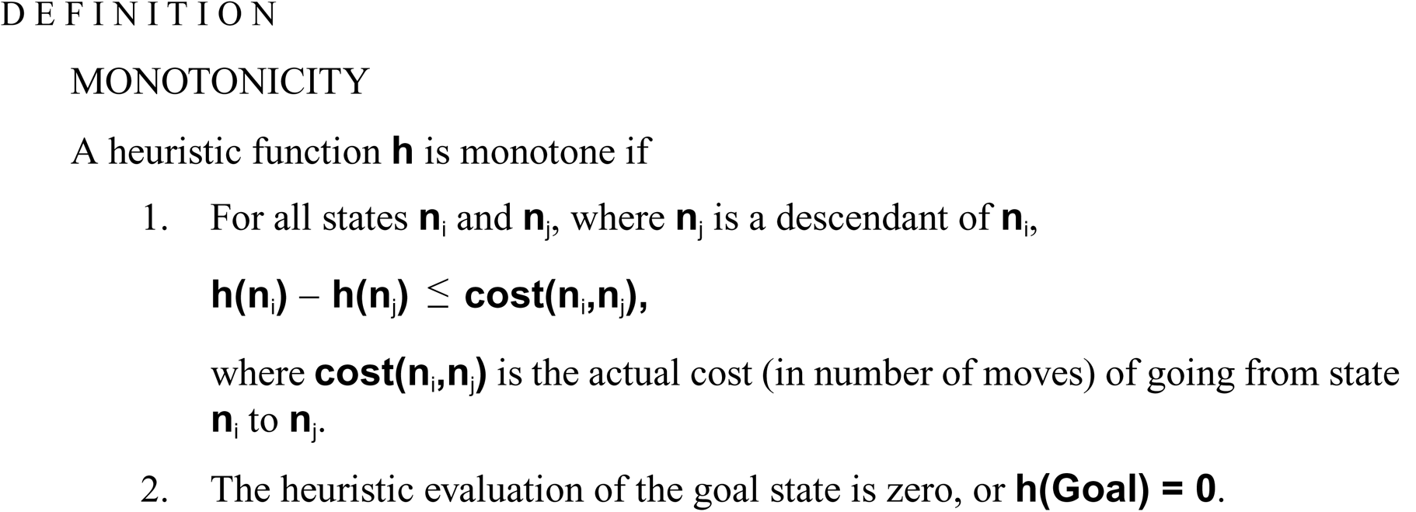

Slide 9
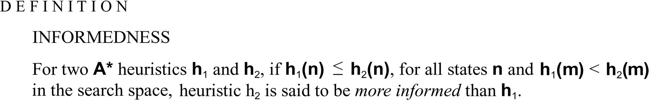
Informed Heuristics
eg. Compare the heuristics proposed for solving the 8-puzzle
h1=> breadth-first-search with heuristic h1(x)=0 for all states x
h2=> #of tiles out of place
h1<= h2 <= h*, h2 is more informed and evaluates many fewer states
The more informed an A* algorithm, the less of the space it needs to expand to get the optimal solution

Slide 10
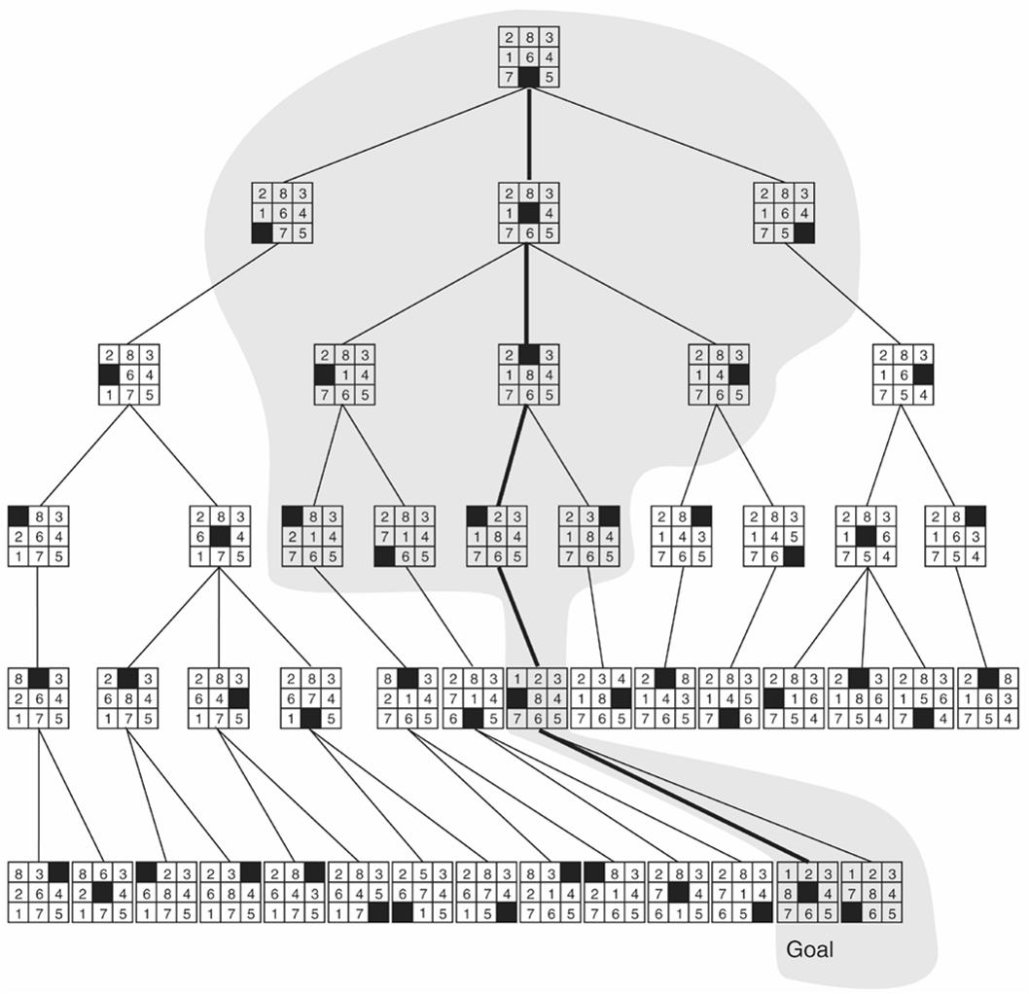
Comparison of state space searched using heuristic search with space searched by
breadth-first search. The portion of the graph searched heuristically is shaded.
The optimal solution path is in bold. Heuristic used is f(n) = g(n) + h(n) where h(n) is
tiles out of place.

Slide 11
Heuristics in Games
Game player must use heuristics to guide play along a path to a winning state
Eg. game nim, player divide tokens into 2 piles of different size; eg. 6 token => 1-5,2-4 NOT 3-3

Slide 12
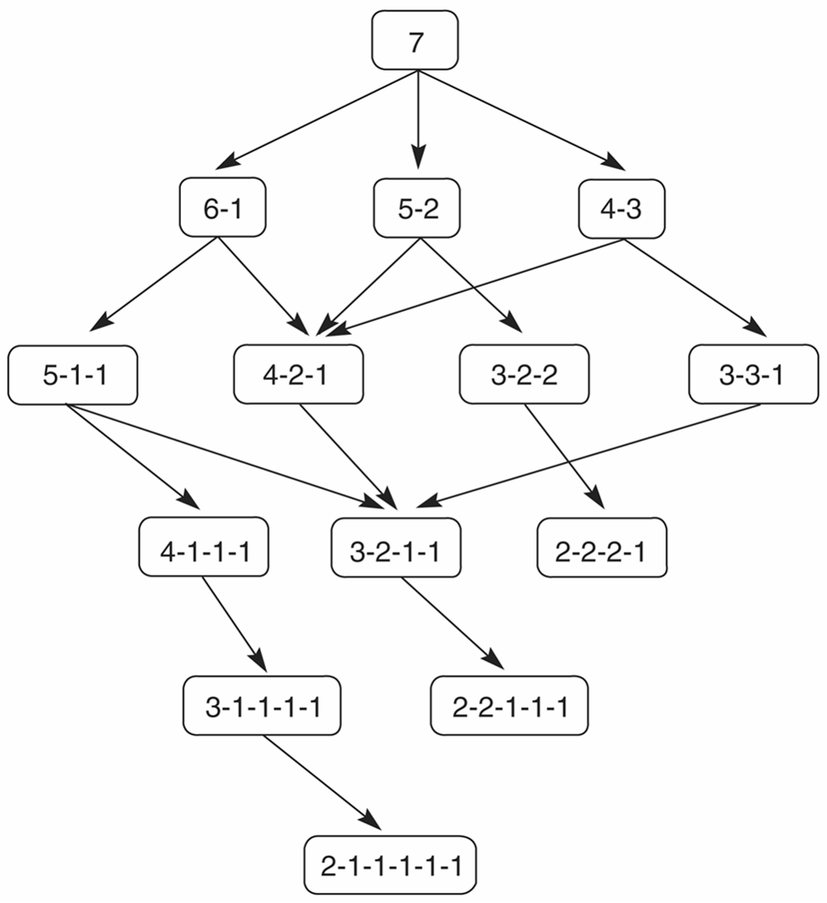
State space for a variant of nim. Each state partitions the seven matches into one or more piles.

Slide 13
Heuristics in Games-MINIMAX procedure
Predicting opponent’s behavior, use MINIMAX procedure to search the game space
Rules of MINIMAX:
  If parent state =MAX, give max value among children
  If parent state=MIN, give min value of its children
  Win for MAX (node=1), Win for MIN (node=0)

Slide 14
Minimaxing to fixed Ply depth
In complicated games, it is impossible to expand the state graph out to leaf nodes.
Instead, state space is searched to predefined number of levels, called n-ply-look-ahead.
Look-ahead allow the heuristic to be applied over greater area of space.
How?
  States on that ply are measured heuristically,
  the values are propagated back up using minimax,
  Search algo uses these values to select possible next moves

Slide 15
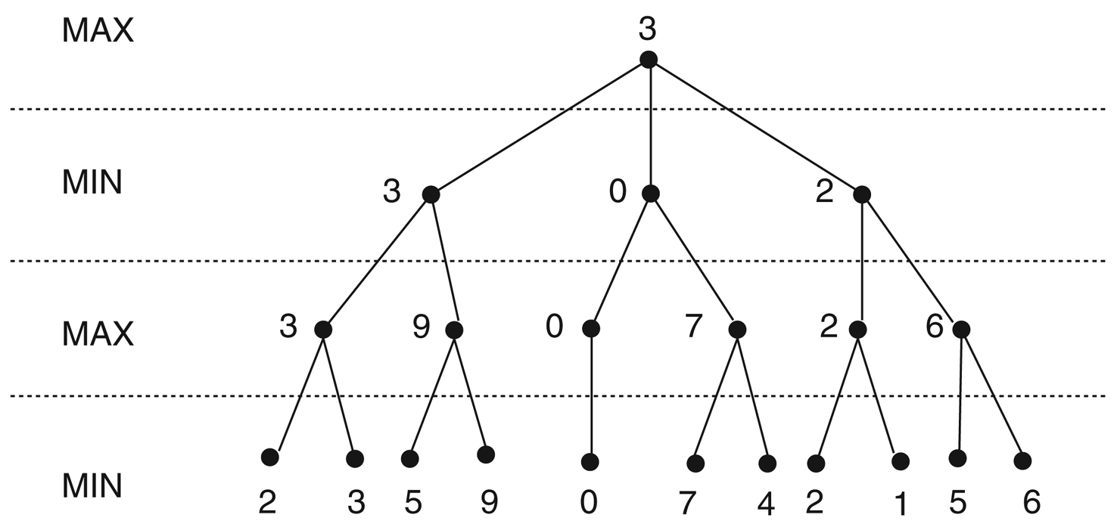
Minimax to a hypothetical state space. Leaf states show heuristic values; internal states show backed-up values.
If parent =MAX,assign max value of its children
If parent =MIN,assign min value of its children
Heuristic values

Slide 16
PBVs
A PBV is a preliminary backed-up value
  Explore down to a given level using depth-first search
  As you reach each lowest-level node, evaluate it using your heuristic function
  Back up values to the next higher node, according to the following rules:
    If it’s your move, bring up the largest value, possibly replacing a smaller value
    If it’s your opponent’s move, bring up the smallest value, possible replacing a larger value

Slide 17
Example: Using PBVs
• Do a DFS; find an 8 and bring it up
Your
move
• Explore 5; smaller than 8, so ignore it
• Backtrack; bring 8 up another level
8
• Explore 2; bring it up
Opponents
move
• Explore 9; better than 2, so bring it
up, replacing 2
8
2
9
• 9 is not better than 8 (for your
opponent), so ignore it
Your
move
• Explore –3, bring it up
8
5
2
9
-3
• Etc.

Slide 18
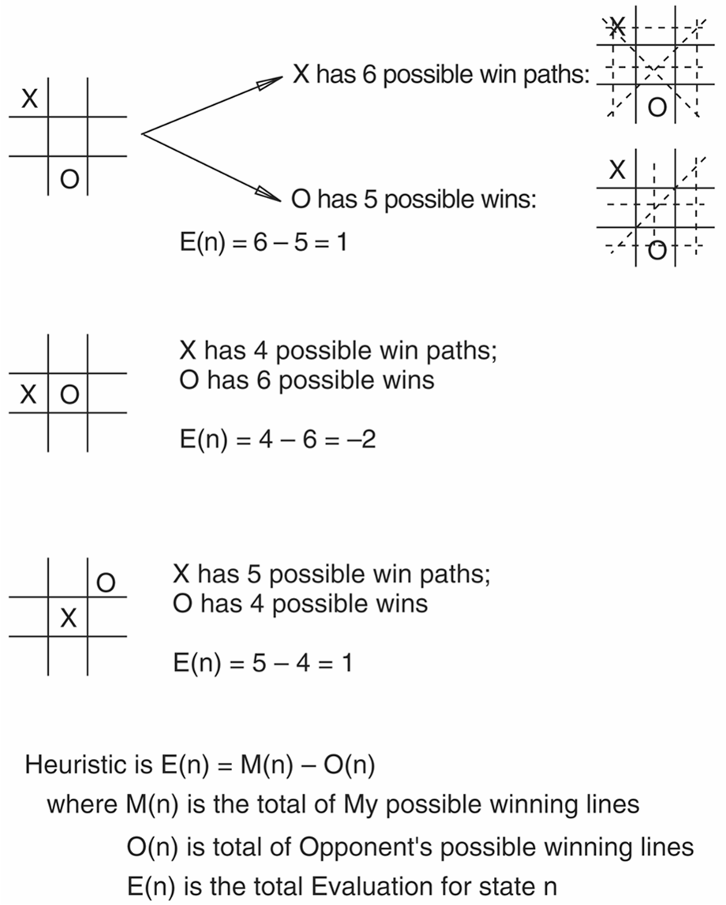
Ex: How to calculate heuristic values?
Heuristic measuring conflict applied to states of tic-tac-toe.

Slide 19
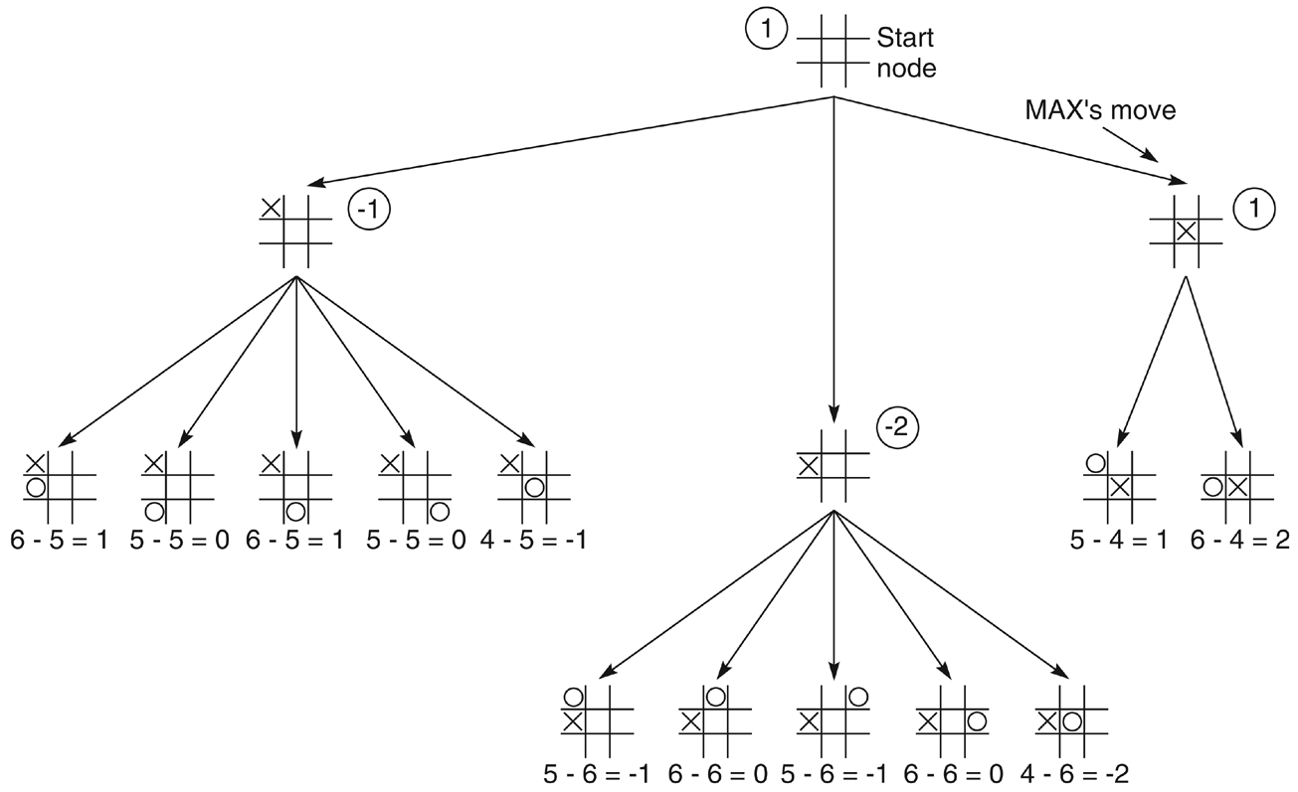
FIXED FLY DEPTH:Two-ply minimax applied to the opening move of tic-tac-toe, from Nilsson (1971).
MAX MOVE
MIN MOVE
Step1:expand the tree
Step2:calculate heuristic for level n
Step3:derived values for n-1 (propogate values back-up)

Slide 20
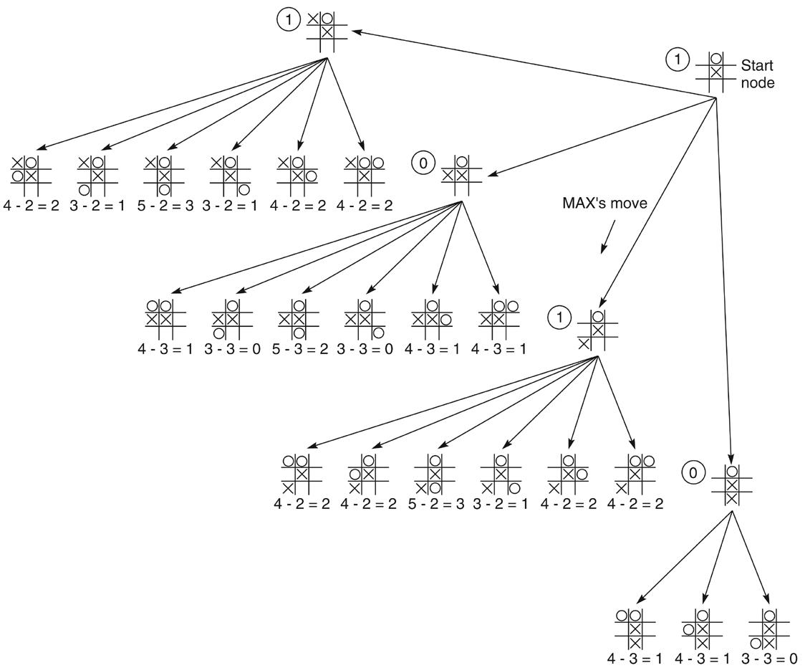
Two-ply minimax and one of two possible MAX second moves, from Nilsson (1971).
-Max middle
-min top
-Max ??
Step4:choose best move for MAX
Repeat step1-step3

Slide 21
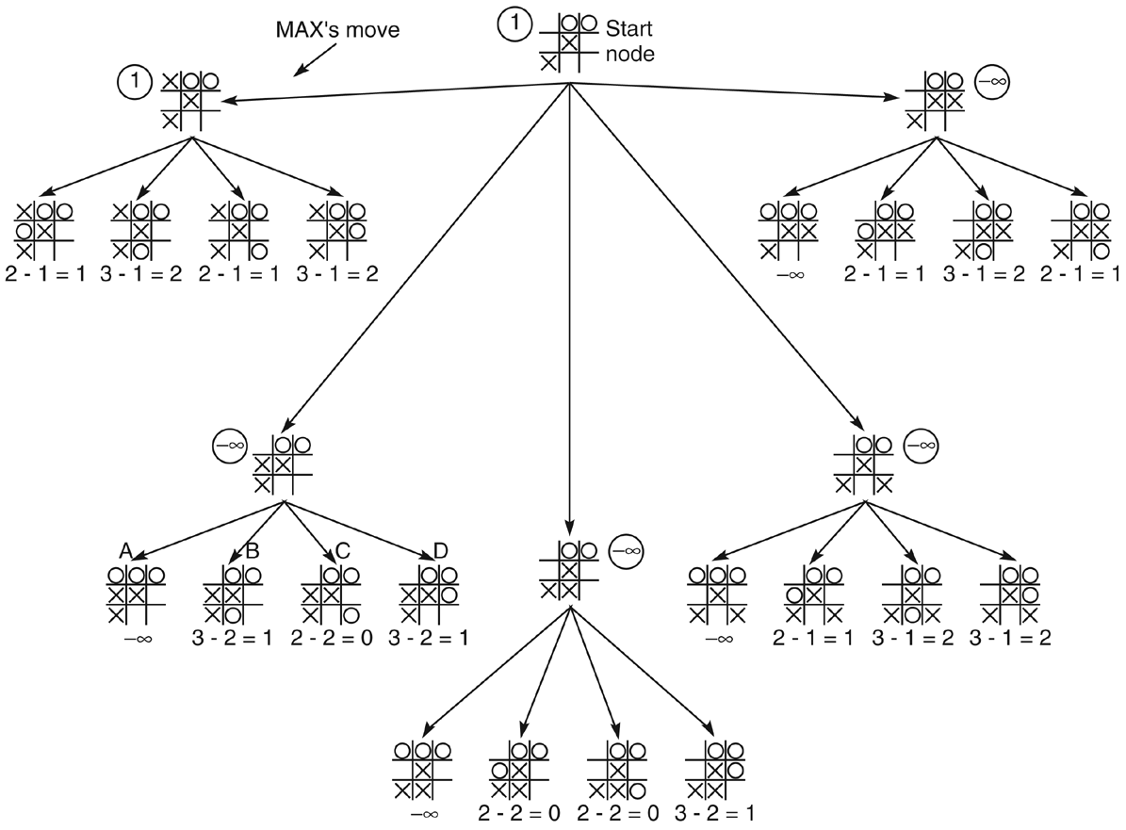
Figure 4.19: Two-ply minimax applied to X’s move near the end of the game, from Nilsson (1971).
Forced win for MIN -inf
Step..N:choose best move for MAX
Repeat all steps until MAX WIN

Slide 22
Alpha-beta pruning
To improve search efficiency in two-person games (compared to minimax that always pursues all branches in state space)
Alpha-beta search in depth-first fashion
Alpha(α) and beta(β) values are created
α associates with MAX-never decrease
β associates with MIN-never increase
How?
  Expand to full-ply
  Apply heuristic evaluation to a state and its siblings
  Back-up to the parent
  The value is offered to grantparent as a potential α or β cutoff

Slide 23
Alpha-beta pruning
Two rules to stop alpha-beta searching:
  For MIN node, if β <= α of MAX ancestor
  For MAX node, if α >= β of MIN ancestors
Alpha-beta pruning :- expresses relation between nodes at ply n and ply n+2 under which entire subtrees rooted at level n+1 can be eliminated(pruned) from consideration
Alpha-beta pruning can effectively double the depth of search tree with same constraint of space and time-search in only one pass, with mimimax two-pass.

Slide 24
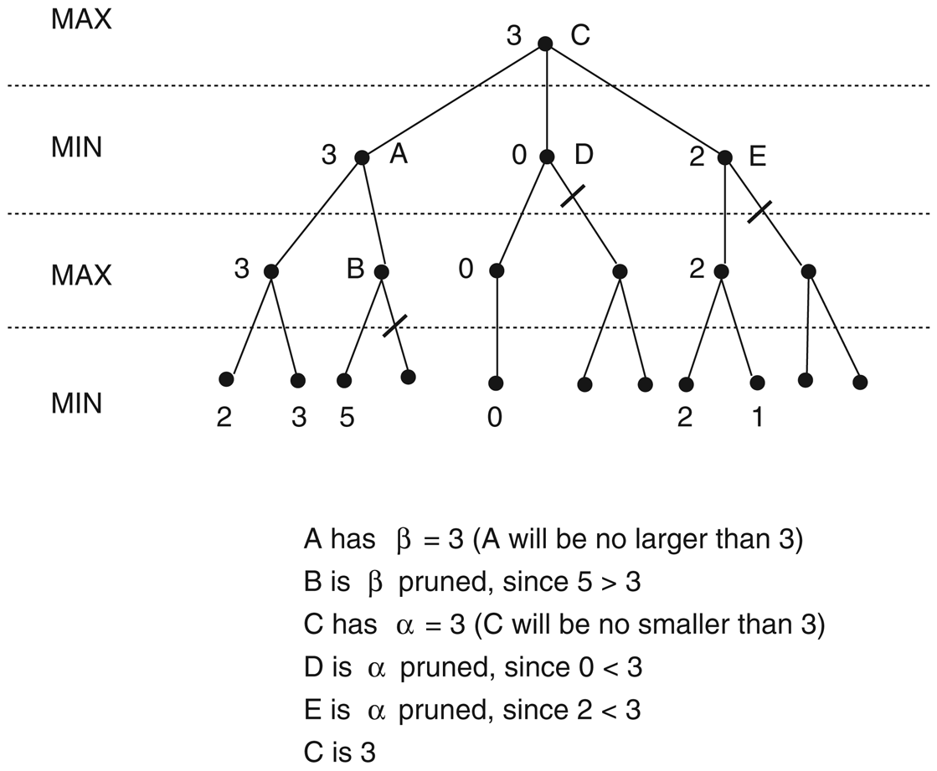
Alpha-beta pruning applied to hypothetical state space. States without numbers are not evaluated.
Depth-first fashion
Example 1

Slide 25
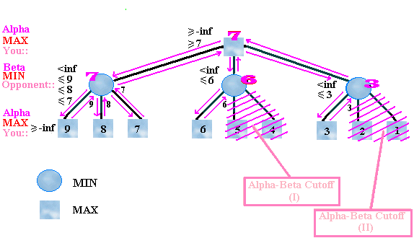
Alpha-beta pruning : example 2

Slide 26
The Alpha-Beta Procedure: Example 3
max
min
max
min

Slide 27
The Alpha-Beta Procedure
Example:
max
min
max
β = 4
min
4

Slide 28
The Alpha-Beta Procedure
Example:
max
min
max
β = 4
min
4
5

Slide 29
The Alpha-Beta Procedure
Example:
max
min
α = 3
max
β = 3
min
4
5
3

Slide 30
The Alpha-Beta Procedure
Example:
max
min
α = 3
max
β = 3
β=1
min
4
5
3
1

Slide 31
The Alpha-Beta Procedure
Example:
max
min
α = 3
max
1<=3
β = 3
β=1
min
4
5
3
1

Slide 32
The Alpha-Beta Procedure
Example:
max
β = 3
min
α = 3
max
β = 3
β=1
β=8
min
4
5
3
1
8

Slide 33
The Alpha-Beta Procedure
Example:
max
β = 3
min
α = 3
max
β = 3
β=1
β=6
min
4
5
3
1
8
6

Slide 34
The Alpha-Beta Procedure
Example:
max
β = 3
min
α = 3
max
α = 6
β = 3
β=1
β=6
min
4
5
3
1
8
6
7

Slide 35
The Alpha-Beta Procedure
Example:
max
β = 3
min
6 >=3
α = 3
max
α = 6
β = 3
β=1
β=6
min
4
5
3
1
8
6
7

Slide 36
The Alpha-Beta Procedure
Example:
α = 3
max
β = 3
min
α = 3
max
α = 6
β = 3
β=1
β=6
min
4
5
3
1
8
6
7

Slide 37
The Alpha-Beta Procedure
Example:
α = 3
max
β = 3
min
α = 3
max
α = 6
α = 3
β = 3
β=1
β=6
min
4
5
3
1
8
6
7
2

Slide 38
The Alpha-Beta Procedure
Example:
α = 3
max
β = 3
min
α = 3
max
α = 6
α = 3
β = 3
β=1
β=6
min
4
5
3
1
8
6
7
2

Slide 39
The Alpha-Beta Procedure
Example:
α = 3
max
β = 3
min
α = 3
max
α = 6
α = 3
β = 3
β=1
β=6
β=2
2<=3
min
4
5
3
1
8
6
7
2

Slide 40
The Alpha-Beta Procedure
Example:
α = 3
max
β = 3
min
α = 3
max
α = 6
α = 3
β = 3
β=1
β=6
β=2
β=9
min
4
5
3
1
8
6
2
9

Slide 41
The Alpha-Beta Procedure
Example:
α = 3
max
β = 3
min
α = 3
max
α = 6
α = 3
β = 3
β=1
β=6
β=2
β=8
min
4
5
3
1
8
6
7
2
9
8

Slide 42
The Alpha-Beta Procedure
Example:
α = 3
max
β = 3
min
α = 3
max
α = 6
α = 3
β = 3
β=1
β=6
β=2
β=7
min
4
5
3
1
8
6
7
2
9
8
7

Slide 43
The Alpha-Beta Procedure
Example:
α = 3
max
β = 3
β = 7
min
α = 3
max
α = 6
α = 7
β = 3
β=1
β=6
β=2
β=7
min
4
5
3
1
8
6
7
2
9
8
7

Slide 44
The Alpha-Beta Procedure
Example:
α = 3
max
β = 3
β=7
min
α = 3
max
α = 6
α = 7
β = 3
β=1
β=6
β=2
β=7
β=9
min
4
5
3
1
8
6
2
9
8
7
9

Slide 45
The Alpha-Beta Procedure
Example:
α = 3
max
β = 3
β=7
min
α = 3
max
α = 6
α = 7
β = 3
β=1
β=6
β=2
β=7
β=8
min
4
5
3
1
8
6
7
2
9
8
7
9
8

Slide 46
The Alpha-Beta Procedure
Example:
α = 3
max
β = 3
β=7
min
α = 3
α = 7
max
α = 6
α = 8
β = 3
β=1
β=6
β=2
β=7
β=8
min
4
5
3
1
8
6
7
2
9
8
7
9
8
10

Slide 47
The Alpha-Beta Procedure
Example:
α = 3
max
β = 3
β=7
min
8 >=7
max
α = 3
α = 6
α = 7
α = 8
β = 3
β=1
β=6
β=2
β=7
β=8
min
4
5
3
1
8
6
7
2
9
8
7
9
8
10

Slide 48
The Alpha-Beta Procedure
Example:
α = 3
max
β = 3
β=7
min
α = 3
α = 7
max
α = 6
α = 8
β = 3
β=1
β=6
β=2
β=7
β=8
min
4
5
3
1
8
6
7
2
9
8
7
9
8
10

Slide 49
The Alpha-Beta Procedure
Example:
α = 7
max
β = 3
β=7
min
α = 3
α = 7
max
α = 6
α = 8
β = 3
β=1
β=6
β=2
β=7
β=8
min
4
5
3
1
8
6
7
2
9
8
7
9
8
10

Slide 50
The Alpha-Beta Procedure
Example:
α = 7
max
β = 3
β=7
min
α = 3
α = 7
max
α = 6
α = 8
β = 3
β=1
β=6
β=2
β=7
β=8
min
4
5
3
1
8
6
7
2
9
8
7
9
8
10

Slide 51
Alpha-beta pruning
It is possible to compute the correct minimax decision without looking at every node in the game tree.
Alpha-beta pruning allows to eliminate large parts of the tree from consideration, without influencing the final decision.
51

Slide 52
Final comments about alpha-beta pruning
Pruning does not affect final results.
Entire subtrees can be pruned, not just leaves.
Good move ordering improves effectiveness of pruning.
Alpha-beta pruning can look twice as deep as minimax in the same amount of time.
52

Slide 53
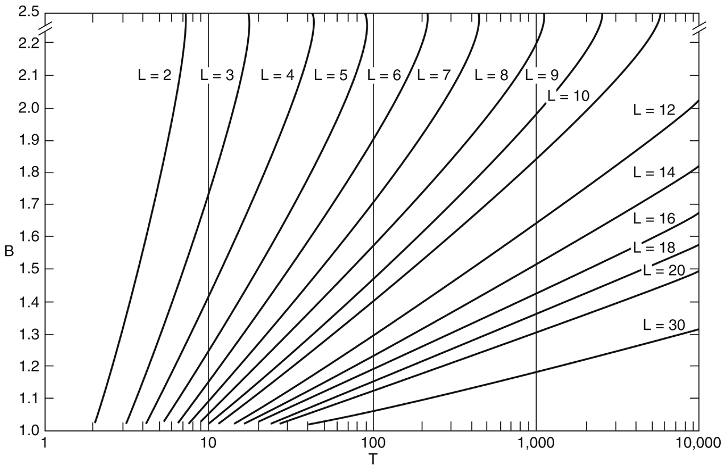
Number of nodes generated as a function of branching factor, for various lengths, L, of solution paths. The relating equation is: T = B(BL - 1)/(B - 1), adapted from Nilsson (1980).
Branching factor-to calculate complexity
Total states at depth n
Analysis: if the Branching factor is 2, it takes search of 100 states to examine all paths six levels deep into search space. And it takes about 10,000 states to consider paths 12 move deep.

Slide 54
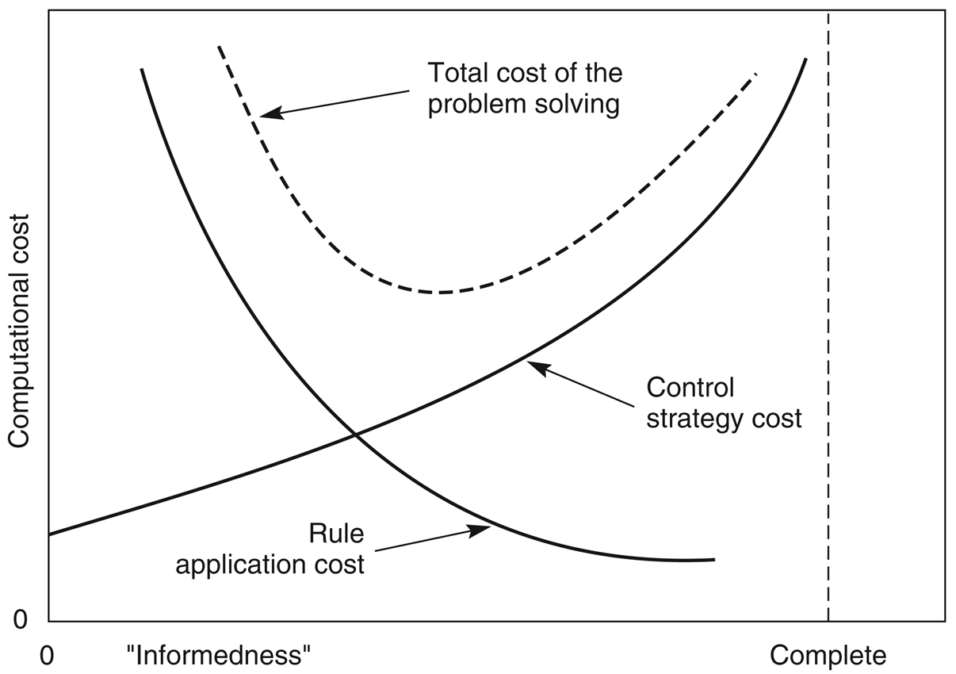
Figure 4.22: Informal plot of cost of searching and cost of computing heuristic evaluation against informedness of heuristic, adapted from Nilsson (1980).

Slide 55
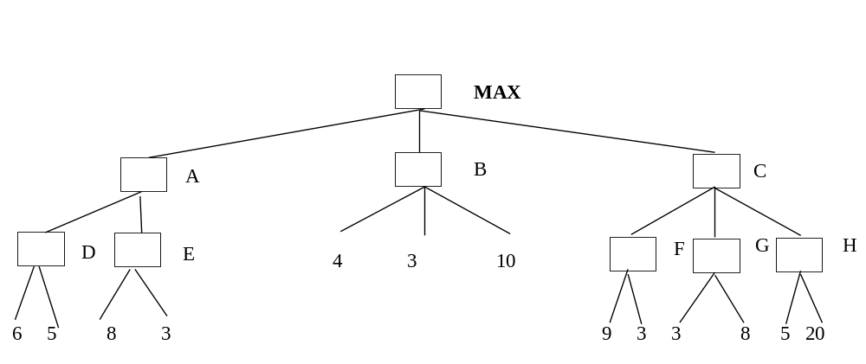
Exercise
Consider the game tree shown below.
Q1.Trace and write the values propagated up the graph for node A, B, C, D, F, G, and H using MINIMAX search.
Q2. Trace and write the values propagated up the graph for node A, B, C, D, F, G, and H using ALPHA BETA PROCEDURE and indicate all parts of the tree that are cut off, and indicate the winning path or paths.
Q3. Analyse your answer between Q1 and Q2 and give your conclusion .

